Slide 1
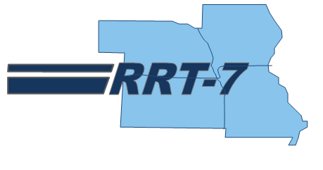




State Report Outs

Slide 2
Add Your State’s Logo Here
Role | RRT Member | Agency | Contact Info
Primary |  |  | Phone: Email:
Alternate |  |  | Phone: Email:
Alternate |  |  | Phone: Email:

Slide 3
Overview
List any focus items
Notes:
Shaken Fury 3-7 June 2019

Slide 4
Agency Organization Chart

Slide 5
Laws/Regulations/Policies
List anything new that the RRT will benefit from knowing
Notes:
National Response Team – Area Contingency Planning (NRT-ACP) Workgroup:
The final AAR from the September workshop was presented to the NRT in December 2019. CG-MER and EPA are seeking final, formal approval from the NRT. Data from the AAR was used to develop a detailed Plan of Action and Milestones (POA&M) that will drive workgroup deliverables. The draft POA&M was distributed and discussed with the workgroup on 28 Jan. The next step is for the workgroup to develop task forces to address the objectives/tasks within the POA&M.
PREP Compliance, Coordination and Consistency Committee (PREP4C):
The PREP4C met on 04Dec19 and agreed to begin working on updated PREP Guidelines v2016.2. Additionally, MER-2 is looking at changing the request for real world credit process as well as evaluating the possibility of changing the full scale exercise cycle from over every four years to one every five years. This would be in alignment with the Area Maritime Security Plan exercise cycle.

Slide 6
Accomplishments
Since last RRT meeting
Federal, state, and local Planning and Coordination Efforts
Description | Location | Dates
Notes:
Accomplishments since last RRT mtg;
A. TRAINING
List training that the RRT participated in or sponsored.
B. EXERCISES/WORKSHOPS
List exercises/workshops that the RRT participated in or sponsored.
C. FEDERAL, STATE, and LOCAL PLANNING AND COORDINATION EFFORTS
Include information on Regional Contingency Plans, Area Plans, or Sub-area Plans; and coordination of LEPC and security plans.

Slide 7
Outlook
Until Next RRT meeting
Federal, state, and local Planning and Coordination Efforts
Description | Location | Dates
Notes:
Projected until next RRT mtg
A. TRAINING
List training that the RRT participated in or sponsored.
B. EXERCISES/WORKSHOPS
List exercises/workshops that the RRT participated in or sponsored.
C. FEDERAL, STATE, and LOCAL PLANNING AND COORDINATION EFFORTS
Include information on Regional Contingency Plans, Area Plans, or Sub-area Plans; and coordination of LEPC and security plans.

